Slide 1
LIFE IN VILLAGE PALAMPUR
CLASS - IX

Slide 2
WHICH IS THE MOST IMPORTANT SECTOR OF THE INDIAN ECONOMY ??
AGRICULTURAL SECTOR
59.70 per cent of India’s population is dependent on agricultural sector.
It is the backbone of the Indian economy .

Slide 3
CHARACTERISTICS OF A VILLAGE
CONNECTIVITY
ECONOMIC ACTIVITIES
EDUCATION
MEDICAL FACILITIES
ELECTRICITY

Slide 4
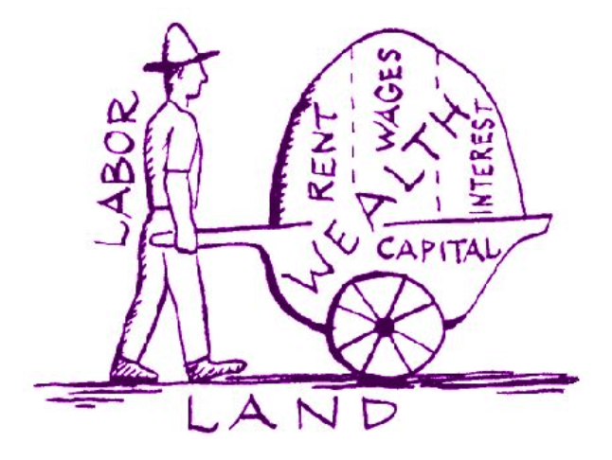
FACTORS OF PRODUCTION

Slide 5
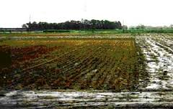
LAND

Slide 6
FEATURES
Land is a free gift of nature . It is neither produced nor is a man made resource.
Land can not be completely destroyed , its permanent
in existence .
Land can not move from one place to another . It lacks geographical mobility.
Land is a fixed factor of production, all cultivable land is used for production . Thus there is no scope to increase farm production or bring new area under cultivation.

Slide 7
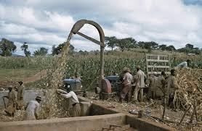
LABOUR

Slide 8
LABOUR
Small farmers along with their families cultivate their own fields.
Medium or large farmers hire farm labourers to work on their land.
They do not have right over the crop grown instead they are paid wages which are in form of cash or kind.
Types of labour-
Skilled
Unskilled

Slide 9
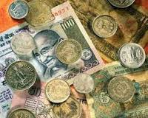
CAPITAL
It refers to the cash or assets that are used in further production of goods and services.
WORKING FIXED
(raw materials , (one time invest-
money in hand ) -ment eg: tools ,
machines ,land)
CAPITAL

Slide 10
HUMAN CAPITAL
ALSO KOWN AS ENTREPRENEURSHIP .
he/ she uses intellect and knowledge to combine all factors in an optimum manner so as to earn maximum profits.
FUNCTIONS OF HUMAN CAPITAL
1) plans ,organise and supervises the work
2)coordinates and correlates other factors of production
3) improves quality of life
4) raises efficiency and skills

Slide 11
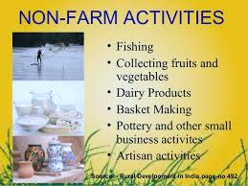

Slide 12
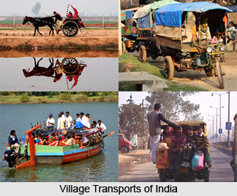
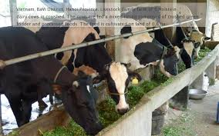
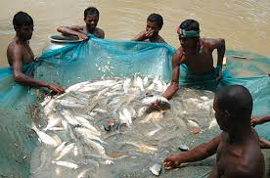
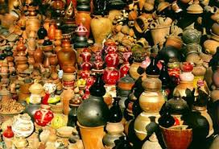
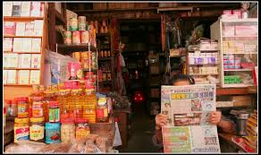
OTHER NON- FARMING ACTIVITIES

Slide 13
CREDIT TO SMALL FARMERS
MONEY LENDERS
LARGE FARMERS AND RELATIVES
TRADERS

Slide 14
CREDITS TO LARGE FARMERS
COMMERCIAL BANKS
COOPERATIVE BANK

Slide 15
METHODS TO INCREASE FARMING
TRADITIONAL METHOD
MORDERN METHOD
CHEMICAL FERTILISERS,
PESTICIDES , IMPROVED VARIETES OF SEEDS , AGRICULTURAL MACHINERY, EXTENSIVE IRRIGATION
USE OF ORGANIC MANURES ,SEEDS, SIMPLE PLOUGH , AND PRIMITIVE AGRICULTURAL TOOLS.
MULTIPLE CROPPING
GREEN REVOLUTION
KHARIF CROPS
RABI CROPS

Slide 16
Lead to harmful effects on the health of the farmers
Loss of soil fertility and water pollution.
Kill use full insect.
DRAWBACKS OF MODERN FARMING METHODS
Require high amount of energy consumption
Cause destruction of environmental resources
Reduce water level due to continuous use of ground water

